Slide 1
User Experience

Slide 5
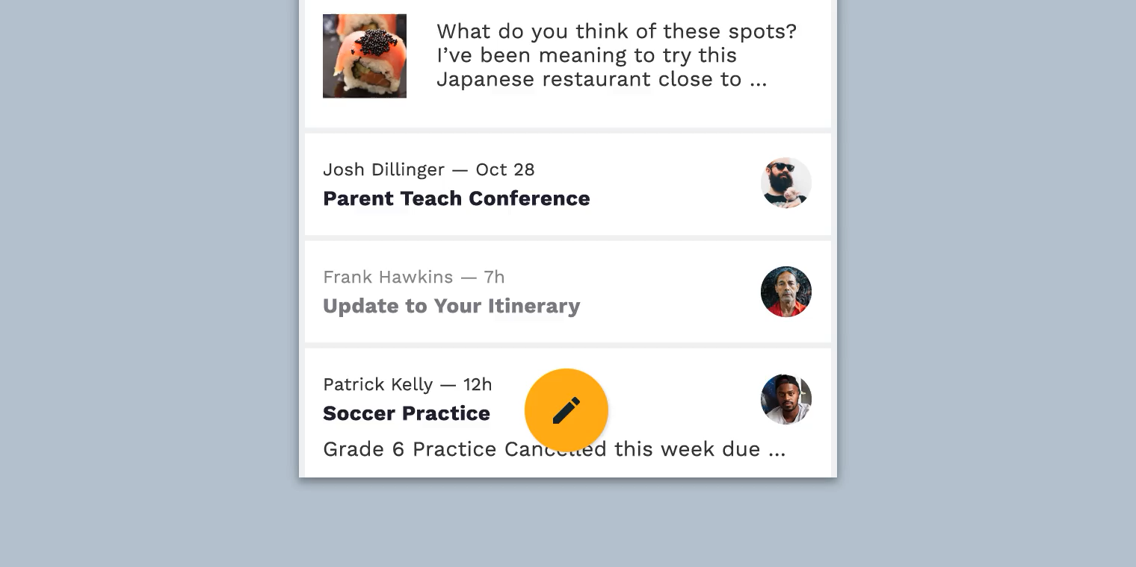

Slide 6
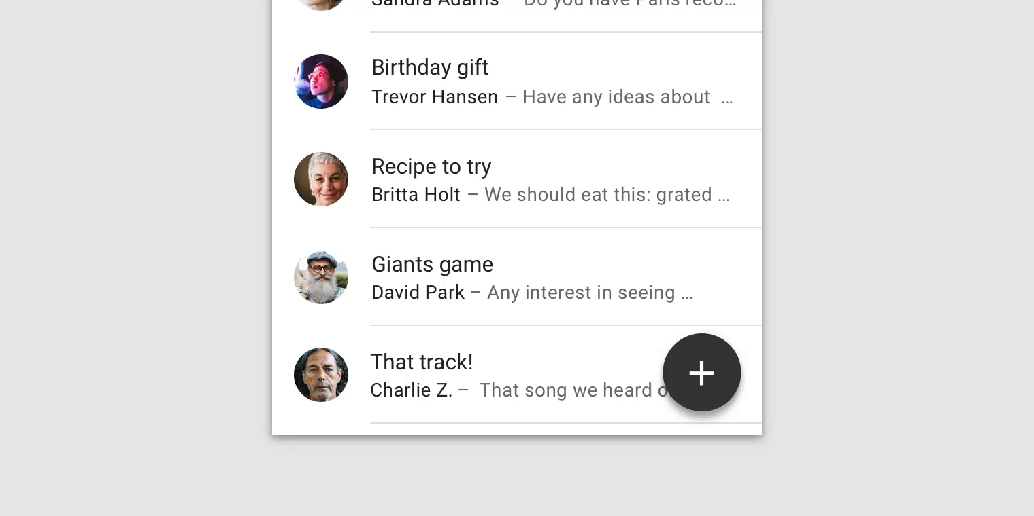


Slide 7
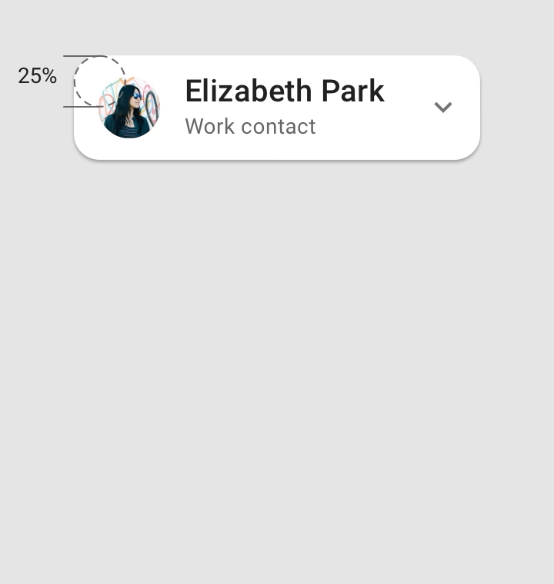
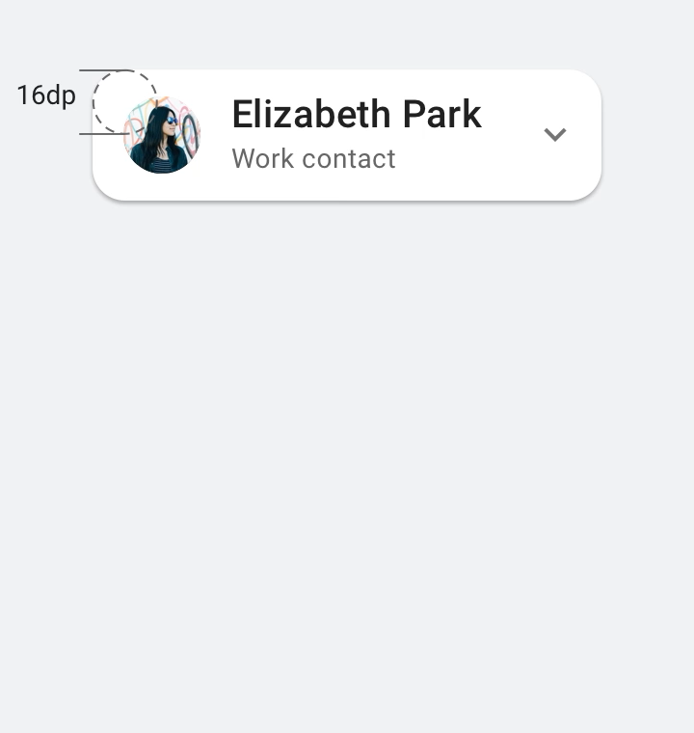

Slide 8
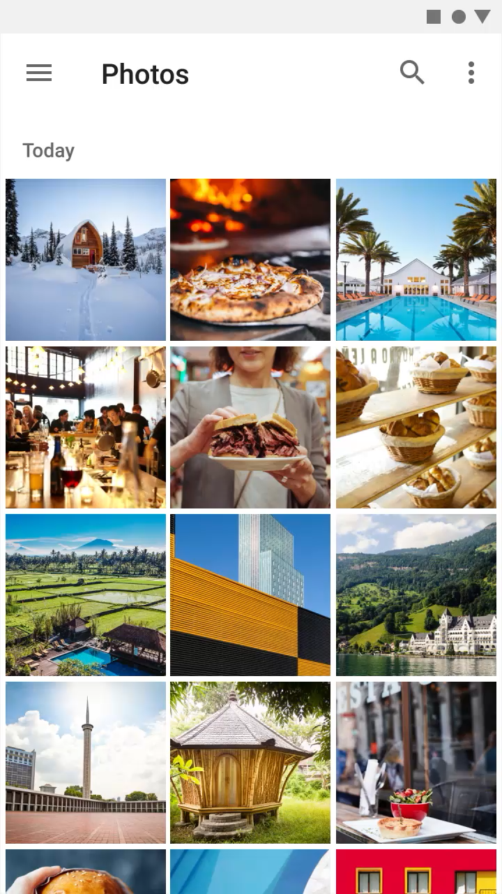
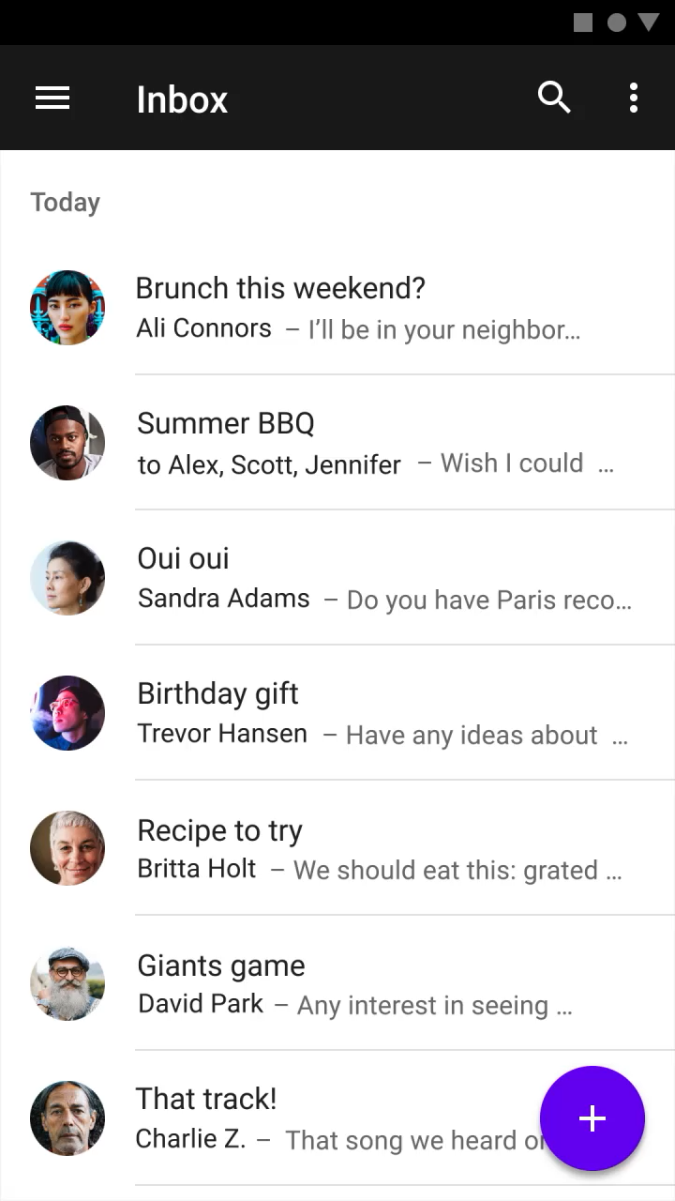

Slide 9
UX in Android

Slide 10
UX in Android
Drawables

Slide 11
UX in Android
Drawables
Styles

Slide 12
UX in Android
Drawables
Styles
Theme

Slide 13
Why do we should care?

Slide 14
Why do we should care?
Performance

Slide 15
Why do we should care?
Performance
Accuracy

Slide 16
Why do we should care?
Performance
Accuracy
Responsiveness

Slide 17
Why should developers care?

Slide 18
Why should developers care?
Faster

Slide 19
Why should developers care?
Faster
Reduce code

Slide 20
Drawable

Slide 21
Drawable
Generic class used to present any kind of graphic

Slide 22
Drawable
Generic class used to present any kind of graphic
Bitmap

Slide 23
Drawable
Generic class used to present any kind of graphic
Bitmap – Shape drawable

Slide 24
Drawable
Generic class used to present any kind of graphic
Bitmap – Shape drawable – Layer List

Slide 25
Drawable
Generic class used to present any kind of graphic
Bitmap – Shape drawable – Layer List
Vector drawable

Slide 26
Drawable
Generic class used to present any kind of graphic
Bitmap – Shape drawable – Layer List
Vector drawable – Transition drawable

Slide 27
Drawable
Generic class used to present any kind of graphic
Bitmap – Shape drawable – Layer List
Vector drawable – Transition drawable

Slide 28
Drawable
Generic class used to present any kind of graphic
Bitmap – Shape drawable – Layer List
Vector drawable – Transition drawable
etc…

Slide 29
Bitmap

Slide 30
.png / .jpeg files

Slide 31
Bitmap files are a set of pixels in a grid
Vector graphics are describing the objects geometrically. (this means vector can scale with no loss of quality

Slide 32
Image asset Studio
Helps you to build multiple versions of each bitmap for different disparate resolutions.
Create your own app icon

Slide 33
Vector asset Studio
Create one image in xml and it will be able to scale for all different devices.
Create your own app icon

Slide 34
Performance
Use smallest resolution
Resize, crop, compress
Vector drawings for simple images
Use Lib: Glide or Picasso
Use lossy image formats and adjust quality where possible

Slide 35
Performance
Image downloading and caching library for Android (glide, Picasso)

Slide 36
Style
Specify the look and feel of individual views in android
Why?
Reduce duplication
Make code more compact
Manage visual appearance of many components with one style.
Inherit and expand of a parent style

Slide 37
Theme
Is a style which applied to an entire activity or even entire application
Applied in the Android Manifest
There are few Android templates “AppTheme”
High-density pixles
Px = dp * (dpi / 160)

Slide 38

Layer List example

Slide 39
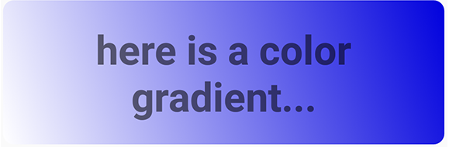
GradientDrawable example

Slide 40
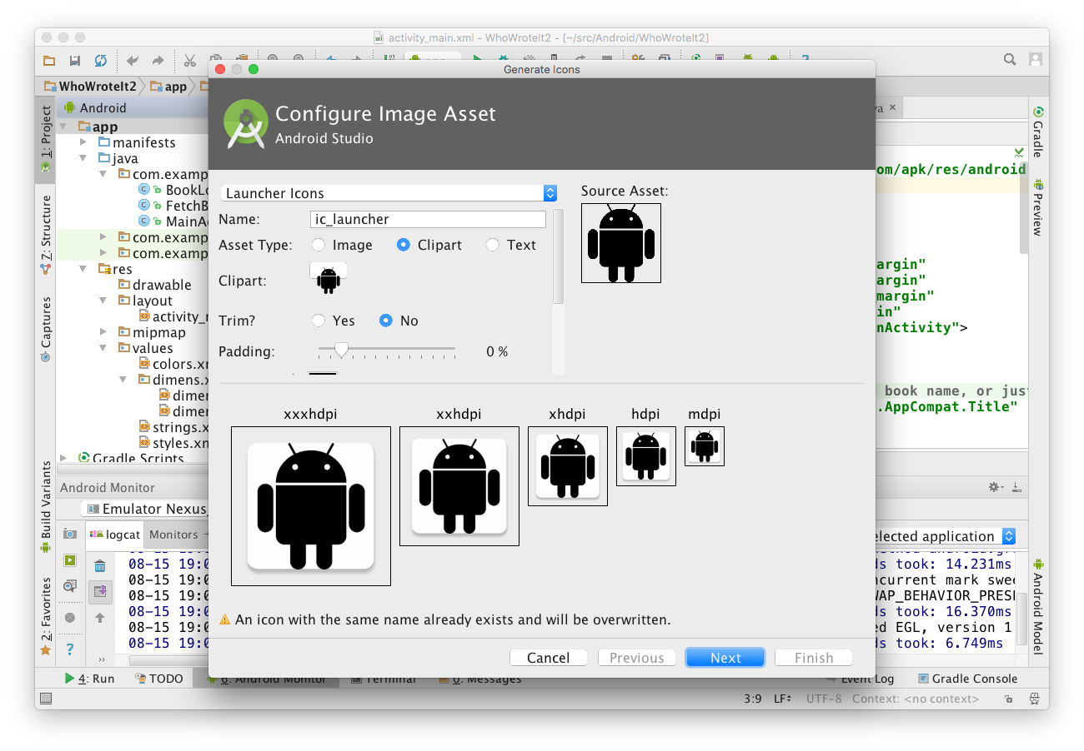
Chose icon typeand change name
Choose Image, Clipart, or Text
Click icon to chose clipart
Inspect assets for multiple screen sizes

Slide 41
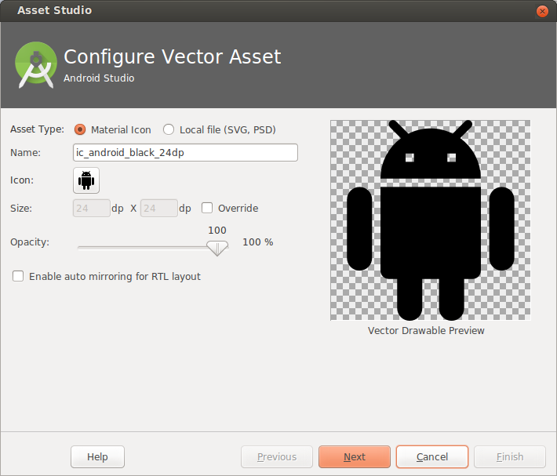
Choose from Material Icon library, or supply your own SVG or PSD vector drawing
Opens Material Icon library

Slide 42
What is a Style?
Collection of attributes that define the visual appearance of a View
Reduce duplication
Make code more compact
Manage visual appearance of many components with one style

Slide 43
<TextView
android:layout_width="match_parent"
android:layout_height="wrap_content"
android:textColor="#00FF00"
android:typeface="monospace"
android:text="@string/hello" />
<TextView
style="@style/CodeFont"
android:text="@string/hello" />

Slide 44
styles.xml is in res/values
<resources>
<style name="CodeFont">
<item name="android:textColor">#00FF00</item>
<item name="android:typeface">monospace</item>
</style>
</resources>

Slide 45
Define a parent style...
<resources>
<style name="CodeFont">
<item name="android:layout_width">match_parent</item>
<item name="android:layout_height">wrap_content</item>
<item name="android:textColor">#00FF00</item>
<item name="android:typeface">monospace</item>
</style>
</resources>

Slide 46
Define child with Codefont as parent
<resources>
<style name="RedCode" parent="@style/Codefont>
<item name="android:textColor">#FF0000</item>
</style>
</resources>

Slide 47
Theme
A Theme is a style applied to an entire activity or even the entire application
Themes are applied in AndroidManifest.xml
<application android:theme="@style/AppTheme">

Slide 48
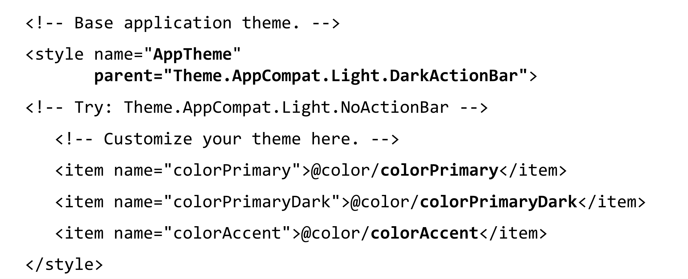
Customize AppTheme of Your Project

